Slide 1
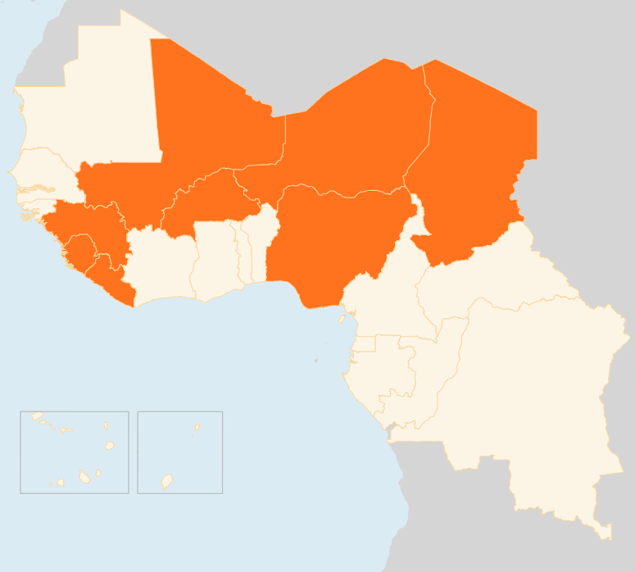

11-17 August 2015
CHAD
FIVE PEOPLE KILLED IN AN ATTACK IN THE LAKE REGION
On 12 August, suspected Boko Haram militants attacked the village of Koyorame in the Lake region. Five people were killed, including two refugees. Due to insecurity, new displacements are still being reported in the area. In the past week, hundreds of people have settled in Walerom after having walked for two weeks, fleeing the attack of their village in Nigeria. As of 14 August, there are 11 new IDP sites in the Lake region, hosting over 40,000 people.
MALI
NEW FIGHTING IN THE NORTH
The June peace deal between armed groups in northern Mali was breached in the past week when fighting broke out, killing an unconfirmed number of people. Reports indicate that fighting took place sporadically over the weekend 120 km south of Kidal nearby a known trafficking route.
NIGERIA
150 PEOPLE KILLED IN ATTACK
Reports indicate that up to 150 people drowned in a river or were shot dead fleeing Boko Haram gunmen who raided a remote village in Nigeria's northeastern Yobe state last Thursday. Protection of civilians and access remain key challenges. And to improve humanitarian access in the north UNHAS flights have been introduced.
CONTINUING DISPLACEMENT DUE TO ESCALATING VIOLENCE
On 14 August, UNHCR expressed its concern about the escalating violence in and around Nigeria and its impact on the situation of Nigerian refugees in surrounding host countries, referring to the thousands of people who have been deported or returned to Nigeria from Cameroon and Chad in July and August. The agency reminds governments of their duty to protect asylum-seekers fleeing human rights violations, and to respect the principle of non-refoulement (non-return).
FLOODS/ REGIONAL
BURKINA FASO
Since the start of the rainy season in June, floods and strong winds have been causing severe damage in seven of Burkina Faso’s 13 regions. As of 12 August, eight people have been killed, 54 wounded and 24,354 people affected by flooding and strong winds. Of the affected 2,428 are displaced and being sheltered in schools.
NIGER
At least four people have died and more than 20,000 have been affected by floods in Niger caused by weeks of heavy rain. In Niamey local authorities have warned residents living near the Niger River to leave their homes because of the high risk of floods.
EVD REGIONAL
ONE CASE IN GUINEA, NO NEW CASES IN LIBERIA & SIERRA LEONE
Ebola remains active in Guinea, with one confirmed case over the week and over 500 contacts being tracked. Sierra Leone has reported zero new infections for a string of 10 days. It is the first time since the beginning of the Ebola outbreak in March 2014 that no new cases have been reported for a week. Around 81 contacts remain under quarantine. Meanwhile Liberia is inching toward arriving at becoming once again WHO certified as Ebola-free after having no new cases for more than 35 days.
FLOODS REGIONAL
BURKINA FASO, NIGER
CHAD
MALI
5
NEW FIGHTING IN THE NORTH
KILLED IN ATTACK
NIGERIA
150 KILLED IN ATTACK
EVD REGIONAL
1
CASE IN GUINEA
Creation date: 18 August 2015
Map data sources: UNCS, DevInfo, OCHA.
The boundaries and names shown and the designations used on this map do not imply official endorsement or acceptance by the United Nations

